Slide 1
Research Finance Cognos Golden Reports
Notes:
Launch poll on what golden reports are used by audience first before getting into full presentation

Slide 2
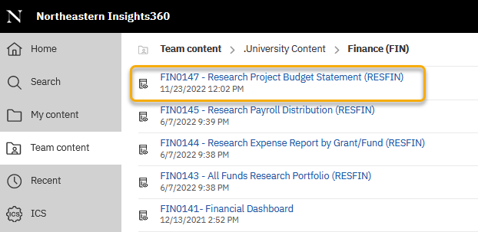
New Golden Reports
Five new research finance golden reports for the Research community. All RESFIN golden reports can be found by using the search function to search for “RESFIN” in Cognos.
Two new FIN reports located in Team Content > .University Content > Finance (FIN):
FIN0146 – Research Cost Share Summary (RESFIN) – temporarily removed from University Content Listing due to GL data access issues
FIN0147 – Research Project Budget Statement (RESFIN)

Slide 3
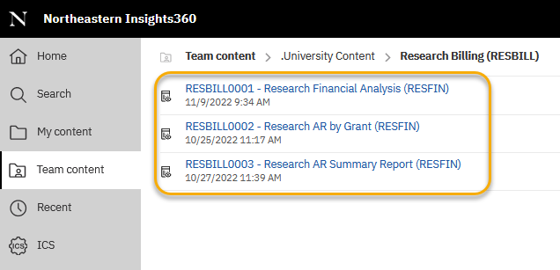
New Golden Reports
Three new RESBILL reports located in Team Content > .University Content > Research Billing (RESBILL):
RESBILL0001 – Research Financial Analysis (RESFIN)
RESBILL0002 – Research AR by Grant (RESFIN)
RESBILL0003 – Research AR Summary Report (RESFIN)
In order to run the RESBILL reports, you will need access to the Research Billing subject area in Cognos.

Slide 4
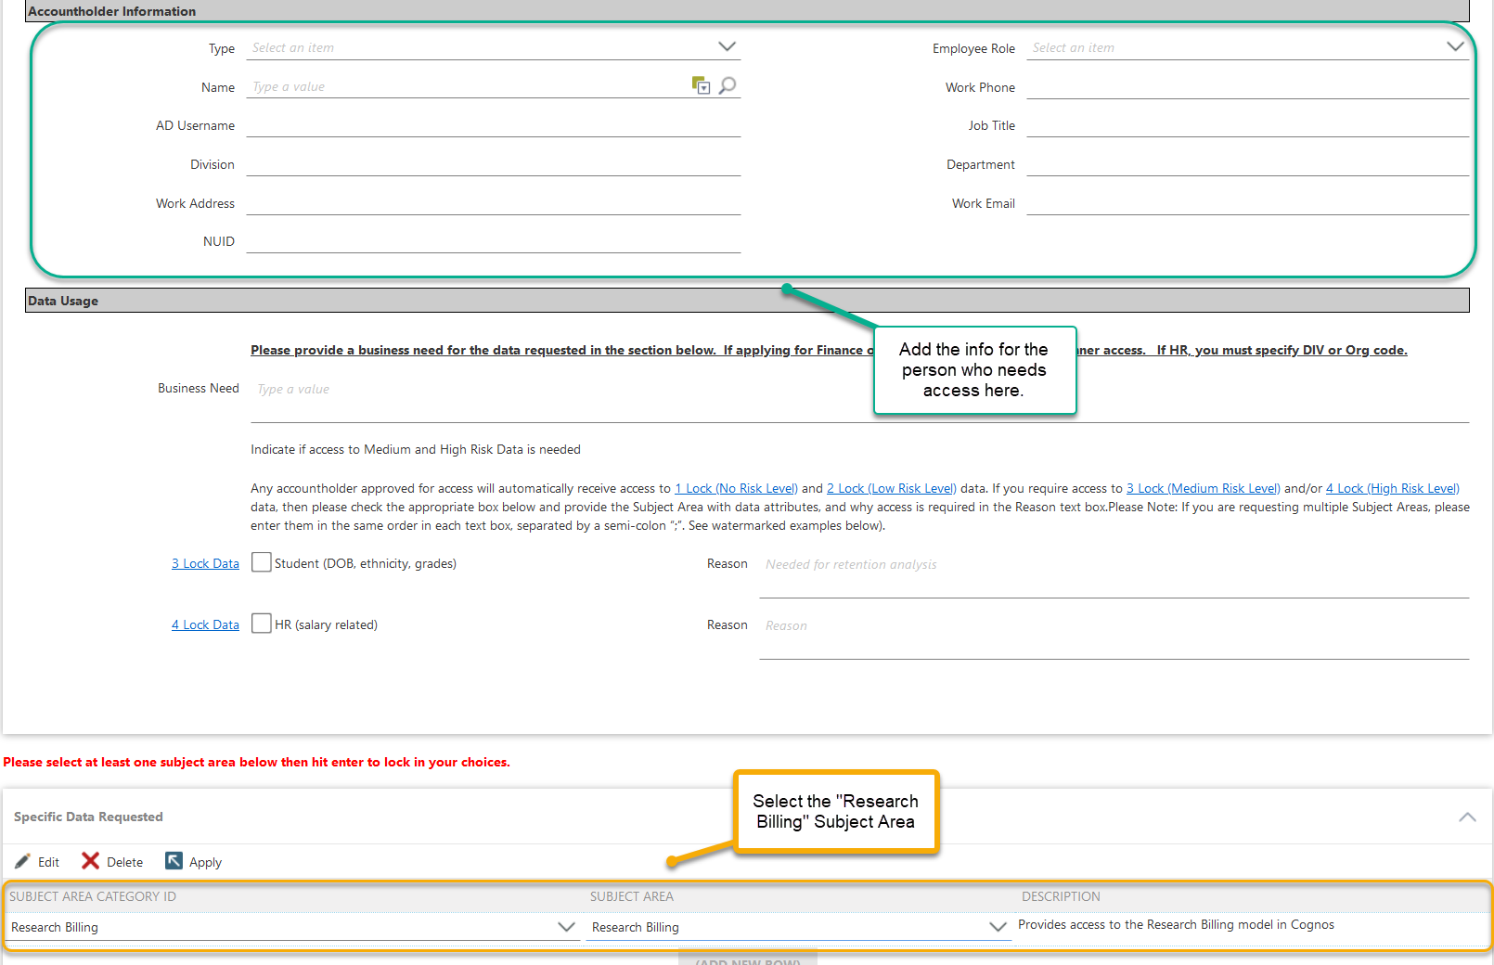
Access to Research Billing Cognos Package
Request access to the RESBILL reports through filling out the normal Cognos access request form as “Change Access” and then adding the Research Billing subject area at the bottom.
https://northeastern.onk2.com/Runtime/Runtime/Form/UDS.AccessRequest.Request/

Slide 5
FIN0146 – Research Cost Share Summary (RESFIN)
This report is a version of the Cost Share Funding Report sent out after the month-close from RESFIN. If you are unable to get access to the Finance Reporting package to run this report on demand, you will still have access to the data via the month-close version delivered to your inbox.
Information on active cost share funds is shown, including ITD actuals and budget, as well as the amount funded for each cost share.
Any cost shares with a fund budget end date of before 2016 or a cost share amount due are excluded from the report.
The following prompt selections are required to run the report:
Fiscal Year
Fiscal Period
In order to run an accurate report, the right access to the general ledger data in Banner is needed.
Notes:
POLL 1 – before slide, ask if people currently get the cost share report that is distributed after the close monthly POLL 2 – at end of slide, ask if people need to be able to run the report on demand, or if the monthly version sent by us sufficient?

Slide 6
FIN0147 – Research Project Budget Statement (RESFIN)
This report is similar to the ePrint report FZRB090 Budget Statement – Inception to Date.
The output shows the budget, expenses, commitments, and available balance for one grant through a selectable start date and end date.
Select grant-level demographic data is also included for reference.
The following prompt selections are required to run the report:
Select a Start Date and an End Date
Default selection is Inception to Date (7/1/1950 start date and current date end date)
Start Date applies to Selected Period Actual Amount only
Select one Grant
There is an option to show the funds which roll up to the grant and cherry pick which funds you’d like to include in the report.

Slide 7
FIN0147 – Research Project Budget Statement (RESFIN)
The data in this report is categorized by account groupings (salaries and wages - temp/PT, salaries and wages - fully benefited, direct costs, and exclusions) for easy analysis, and is aggregated at both the grant and fund level.
Account codes included in the Temp/PT salary grouping:
61040 - Salary-Part-Time Faculty,
61120 - Salary-Professional Extra Comp NBE,
61240 - Salary-Technician < 24 Hours,
61410 - Salary-Overtime-Clerical,
61418 - Salary-Overtime-Service and Trades,
61530 - Salary-Coop
All other salary account codes are included are in the Fully-benefited salary grouping

Slide 8
FIN0147 – Research Project Budget Statement (RESFIN)
Account codes included in the Exclusions grouping (not eligible for IDC):
73001 - Capital Equipment-Office,
73002 - Funded Depreciation,
73003 - Capital Equipment-Laboratory,
73004 - Capital Equipment-Audio Visual,
73005 - Capital Equipment-Computers,
73006 - Capital Fabricated Equipment >5K,
73007 - Capital Equipment-Athletics,
73008 - Capital Software/Dataset >5K,
73009 - Capital Equipment-Musical Instrumnt,
73010 - Equipment >1,500 (Non-Computer),
73011 - Capital Equipment-Motor Vehicles,
73012 - Capital Equipment-Plant Maintenance,
74517 - Sponsored Program Tuition,
74600 - Participant Cost-Stipends,
74601 - Participant Costs - Other,
78312 - Equipment >1,500 (Non-Computer),
78313 - Lease Expense-Operations,
79995 - Indirect Costs
Additionally, any amount over $25k on subcontract account codes (78050 through 78069) are included in the Exclusions grouping and is not eligible for IDC. The first $25k for these account codes is included in the Direct Costs grouping and is eligible for IDC.
All other account codes not listed in the two bullets above are included in the Direct Costs grouping and are eligible for IDC.

Slide 9
Banner Billing – Pros & Cons
PROS
System-generated invoices for certain awards allows for more streamlined approach to billing
Bill formats allows us to organize different payment terms into general categories to group billing
Bills/AR is run on a monthly schedule in batches by bill format
Banner generates invoices and/or AR on Grant level for activity across all funds – allows us to capture concurrent funds/budgets in the same invoice
Controls in place to prevent billing for deficits
Cash is applied against booked AR/invoices, which gives us the ability to track, age, and report Open AR
CONS
Banner system configurations are strict and multiple conditions must be met for an invoice to generate
Due to variation in sponsor requirements, some projects still require manual invoice preparation
Final invoices are not auto-generated and require reconciliation with the College RA/PI
Banner generates invoices and/or AR on Grant level for activity across all funds - not able to run invoices by fund for single consecutive budget periods
Not able to invoice in full if account is overspent
Credit activity on one fund within the total grant activity for the month is recorded by the system as a payment which can affect accurate invoice balances
Notes:
Billing type and format are determined based on contracted invoicing/payment terms and sponsor type
Pros and cons of Banner Billing – better introduction to the process – How does Banner Billing work? - Billing team functions slide combined with overview of how Banner Billing works
Break down into two slides and expand matrix
Add overview of what event schedules are – address on Kruti's slides

Slide 10
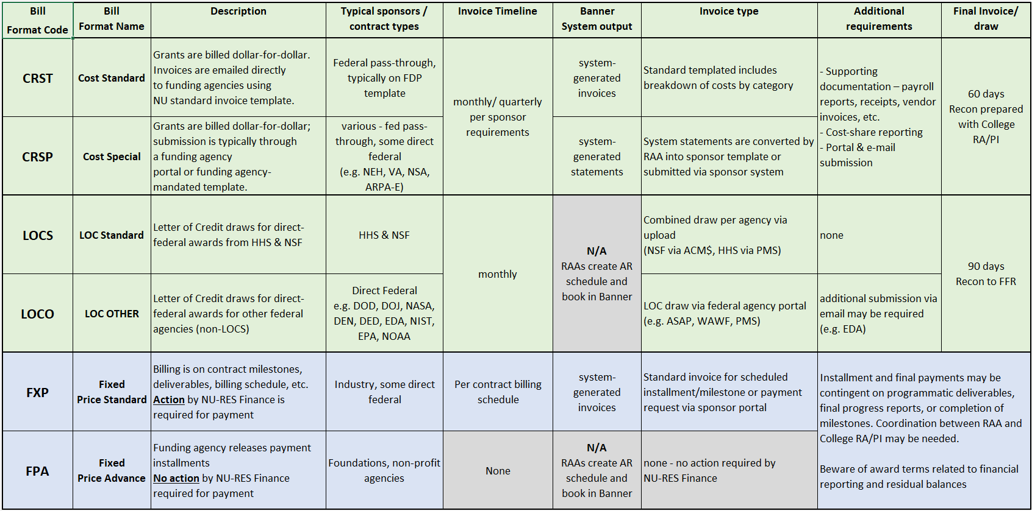
Banner Bill Formats

Slide 11
Billing System Configuration
Cost-reimbursement
$10 billing minimum (Exception – LOCS)
No expenses = no invoice/AR
Credit activity/expenses removed = no invoice/AR
Grant in deficit = no invoice/AR
Deficit review based on combined Grant GL budget
Final invoices are not auto-generated – require recon
CRST/CRSP Billing schedule is set to budget period end date – 1 month
RAAs needs to process a JV if ITD <> final invoice amount
AR is booked via on-demand bill runs, not part of monthly cycle
Fixed-Price
RAAs build schedules in Banner in accordance with the contract billing/payment terms
Changes to billing schedules are only triggered by contract amendments/Banner actions
We do not move AR due to programmatic delays
If there is a delay, the generate invoice will be held until the deliverable is completed
** AR Reports reflect booked AR, NOT what is sent to the sponsor. **
Notes:
Add slide on Banner pitfalls – examples of issues we come across and what do we need the admins to do

Slide 12
RESBILL0002 – Research AR by Grant (RESFIN)
This report shows a summary of the invoices/AR booked in Banner for one or more selected grants and/or PIs. The billing and payment entries associated with the grant(s) are also shown on a separate tab.
Select grant-level demographic data is also included for reference.
One or both of following prompt selections are required to run the report :
Grant Code (one or more)
Grant PI (one or more)

Slide 13
RESBILL0003 – Research AR Summary (RESFIN)
This report shows grant-level or fund-level AR summary including total expenditures, billed, unbilled, hold, and payments. Expense transaction detail by invoice and payment details are included in two additional tabs.
Various demographic data at both the fund-level and grant-level are also included for reference.
This report can be run in two different ways using the prompt page. For either option, fund-level data can be toggled on/off (default is off) and an end date can be selected for the billing data (default is the current date):
Select one grant in the Grant Number prompt
This returns a three-section output: a summary, billing detail, and payment detail for the grant selected
Leave the Grant Number prompt blank
This returns the summary page only for all research funds you have access to.
For either option chosen, please note that fund-org security applies. If he fund detail option is not selected and a grant one or more funds that fall outside of your Banner fund-org security access, the grant-level data will not include the funds you do not have access to and will not show an accurate grant-level total.
Notes:
Cost share funds are EXCLUDED, does not include grants that have a grant project end date before April 2019 (start up of the Banner Billing process).

Slide 14
RESBILL0001 – Research Financial Analysis (RESFIN)
The report combines budget-to-actuals data (ITD budget, period actuals, ITD actuals, ITD commitments, and budget balance remaining) with select AR data (billed amount, unbilled amount, hold amount, open AR amount, and payments and transfers) by fund based on a selected fiscal year and period.
This report includes active funds only.
Select grant-level and fund-level demographic information is also included for reference.
The following prompt selections are required to run the report :
Fiscal Year
Fiscal Period

Slide 15
Upcoming Golden Reports
Six additional reports are in the process of being moved to Golden for Research community use for use later this year (final report titles/numbers TBD):
Payroll Certification Report
Research OL Expense Summary by Account
Expiring Funds with Subcontracts
Equipment Transaction Report
NU-KRI Account Matrix
All Funds – Ledger 3

Slide 16
Helpful Resources
Research Finance Financial Monitoring and Reports Guidance:
https://research.northeastern.edu/nu-res/lifecycle-management/manage-project/financial-monitoring-reporting/
Cognos Access request process:
https://northeastern.sharepoint.com/sites/provost/Data%20Administration/BusinessIntelligenceProgram/SitePages/Getting%20Access.aspx
Cognos FAQ:
https://northeastern.sharepoint.com/sites/provost/Data%20Administration/BusinessIntelligenceProgram/SitePages/Training.aspx

Slide 17
Thank you!
Questions?

